Slide 1
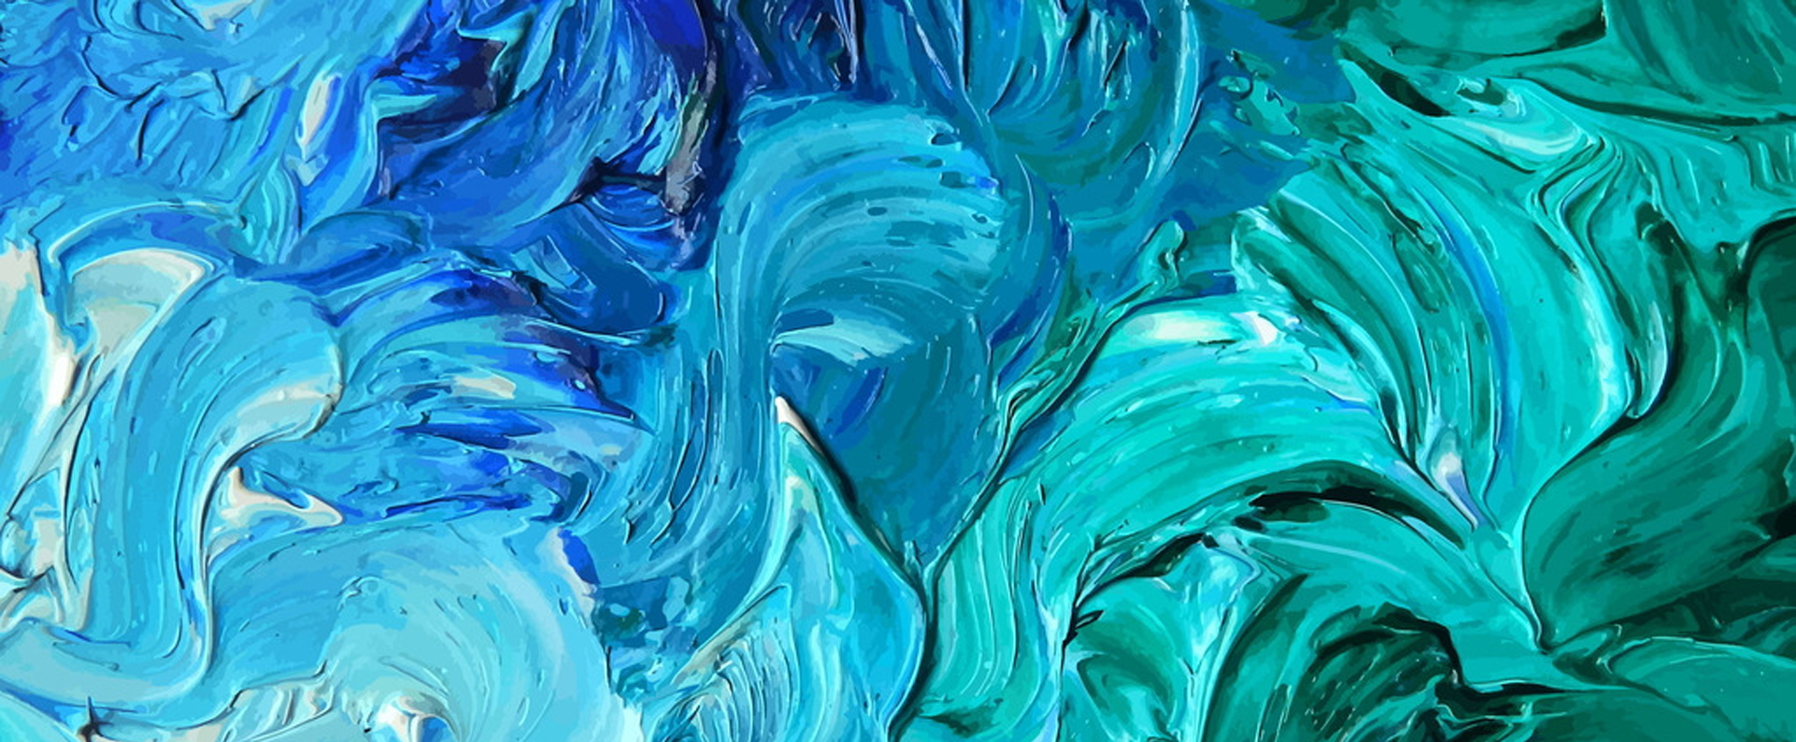
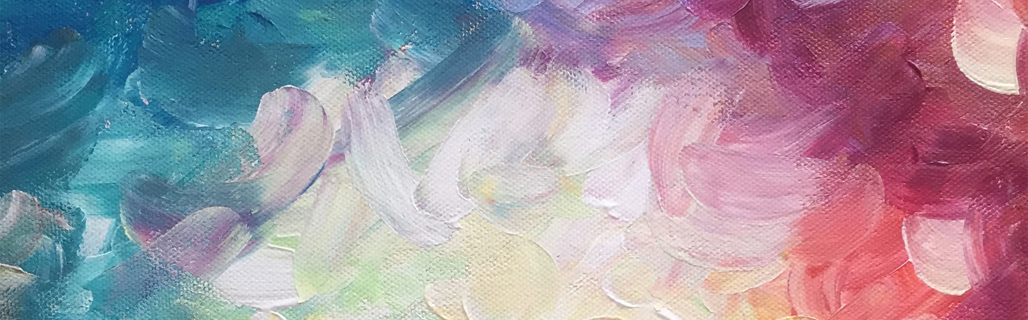
再也不是 的过客

Slide 2
目 录
1
加入你的标题描述
CONTENTS
2
加入你的标题描述
3
加入你的标题描述
4
加入你的标题描述

Slide 3
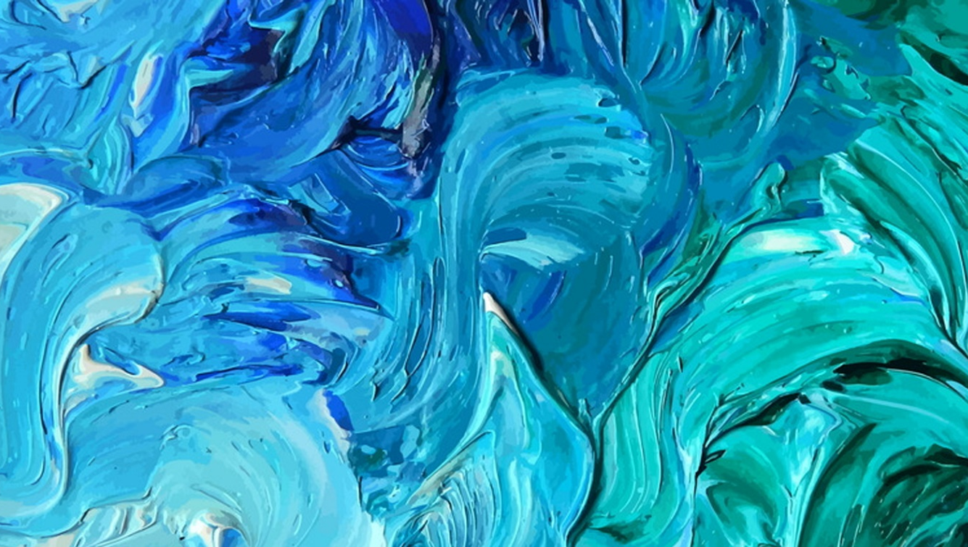
PART 01
加入你的标题描述
This PPT template for the rice husk designer pencil demo works, focusing on the production of high-end design templates, I hope to help your demonstration
This PPT template for the rice husk designer

Slide 4



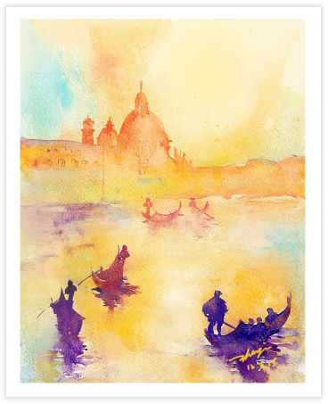
PART.1
添加标题
添加标题
This template is the spring and autumn advertising original This template is the spring and autumn advertising original
This template is the spring and autumn advertising original This template is the spring and autumn advertising original
添加标题
添加标题
This template is the spring and autumn advertising original This template is the spring and autumn advertising original
This template is the spring and autumn advertising original This template is the spring and autumn advertising original

Slide 5

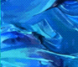
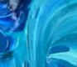

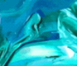




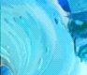



PART.1
点击此处输入标题
This template is the spring and autumn advertising original, here you can directly modify the content. This template is the spring and autumn advertising original, here you can directly modify the content.

Slide 6

PART.1
添加标题
This template is the spring and autumn advertising original, here you can directly modify the content. This template is the spring and autumn advertising original, here you can directly modify the content.

Slide 7
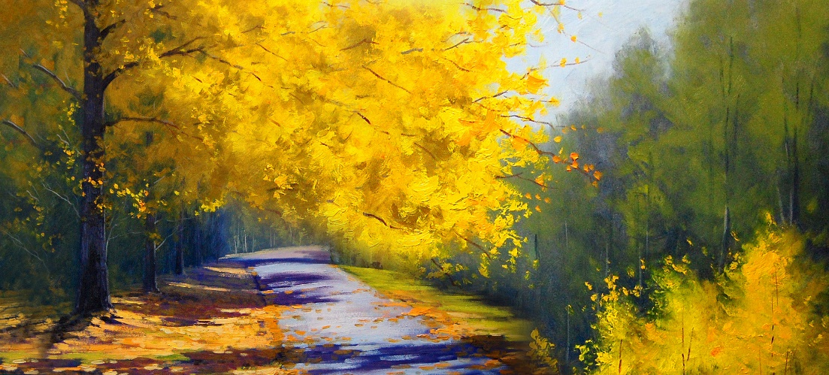
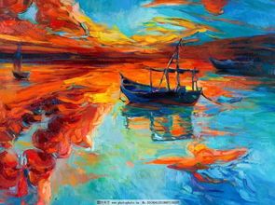
PART.1
Title here
Title here
Title here
Marketer
Marketer
Marketer

Slide 8
PART 02
加入你的标题描述
This PPT template for the rice husk designer pencil demo works, focusing on the production of high-end design templates, I hope to help your demonstration
This PPT template for the rice husk designer

Slide 9
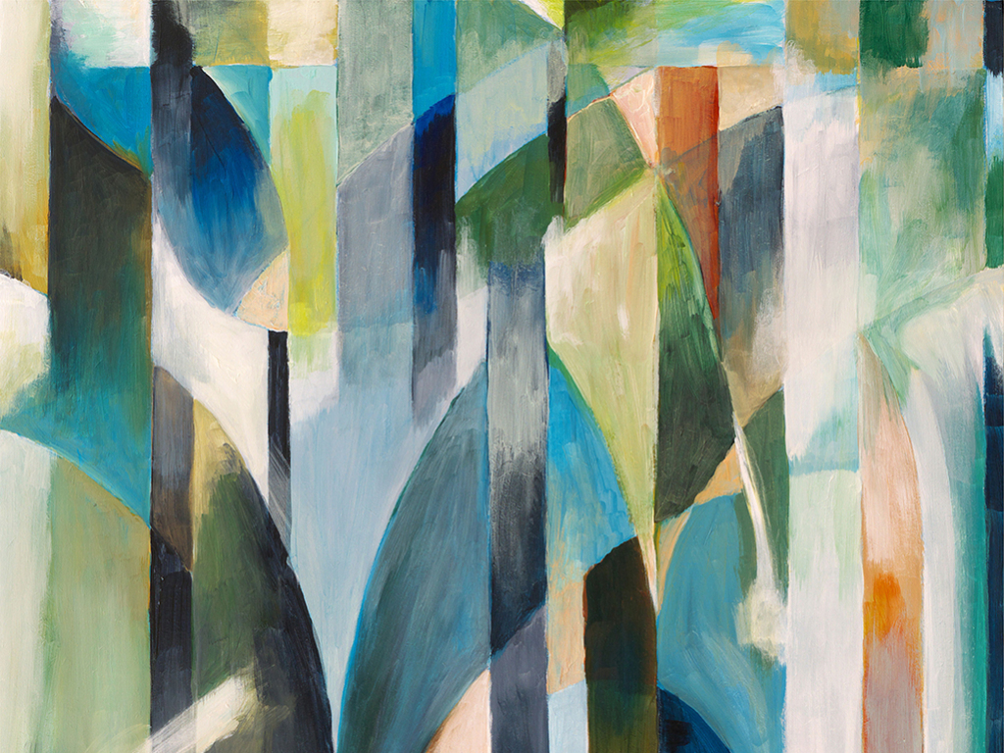
PART.2
标题文字添加
The user can demonstrate on a projector or computer, or print the presentation and make it into a film to be used in a wider fieldThe user can demonstrate on a projector or computer, or print the presentation and make it into a film to be used in a wider field
The user can demonstrate on a projector or computer, or print the presentation and make it into a film to be used in a wider fiel

Slide 10

PART.2
This template is the spring and autumn advertising original, here you can directly modify the content. This template is the spring and autumn advertising original, here you can directly modify the content.
添加标题
This template is the spring and autumn advertising original This template is the spring and autumn advertising original

Slide 11

PART.2
添加标题
This template is the spring and autumn advertising original This template is the spring and autumn advertising original
添加标题
This template is the spring and autumn advertising original This template is the spring and autumn advertising original
添加标题
This template is the spring and autumn advertising original This template is the spring and autumn advertising original
添加标题
This template is the spring and autumn advertising original This template is the spring and autumn advertising original

Slide 12
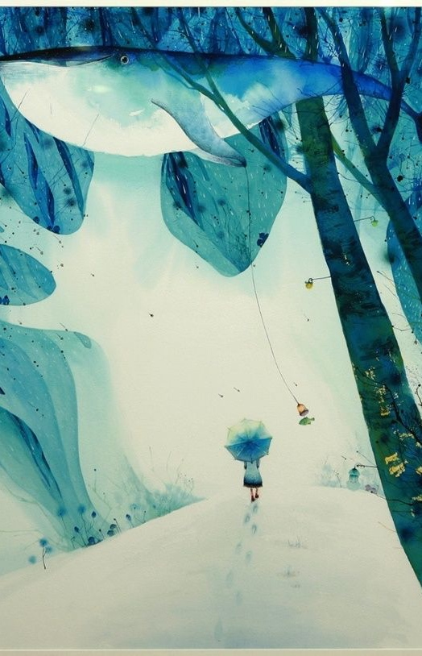
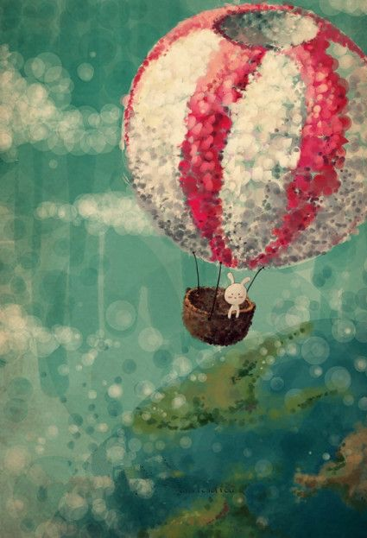
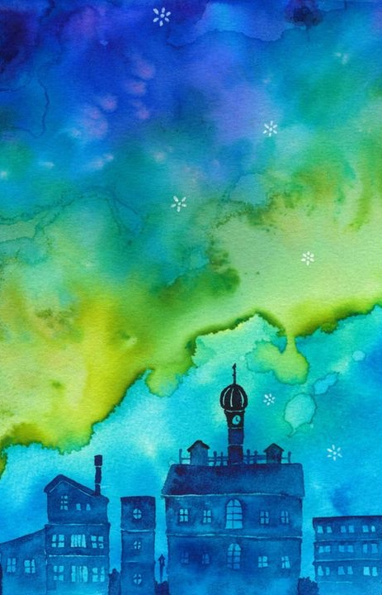
PART.2
Title here
Title here
Title here
Marketer
Marketer
Marketer

Slide 13

PART.2
添加标题
This template is the spring and autumn advertising original, here you can directly modify the content. This template is the spring and autumn advertising original, here you can directly modify the content.

Slide 14
PART 03
加入你的标题描述
This PPT template for the rice husk designer pencil demo works, focusing on the production of high-end design templates, I hope to help your demonstration
This PPT template for the rice husk designer

Slide 15

PART.3
输入标题
Just for today I will exercise my soul in three ways. I will do somebody a good turn Just for today I will exercise my soul I will do somebody a good turn

Slide 16

PART.3
添加标题
添加标题
01
02
This template is the spring and autumn advertising original This template is the spring and autumn advertising original
This template is the spring and autumn advertising original This template is the spring and autumn advertising original
添加标题
添加标题
03
04
This template is the spring and autumn advertising original This template is the spring and autumn advertising original
This template is the spring and autumn advertising original This template is the spring and autumn advertising original

Slide 17

PART.3
此处输入标题
Just for today I will exercise my soul in three ways. I will do somebody a good turn Just for today I will exercise my soul I will do somebody a good turn

Slide 18
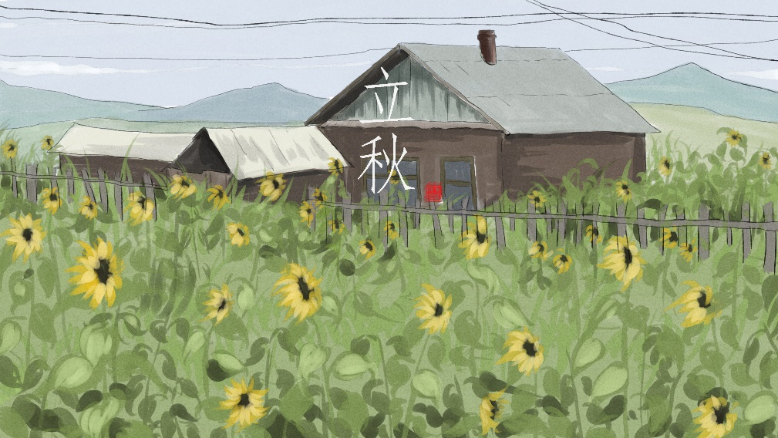

PART.3
添加标题
This template is the spring and autumn advertising original, here you can directly modify the content. This template is the spring and autumn advertising original, here you can directly modify the content.
添加标题
This template is the spring and autumn advertising original, here you can directly modify the content. This template is the spring and autumn advertising original, here you can directly modify the content.

Slide 19
PART 04
加入你的标题描述
This PPT template for the rice husk designer pencil demo works, focusing on the production of high-end design templates, I hope to help your demonstration
This PPT template for the rice husk designer

Slide 20
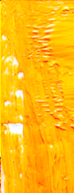
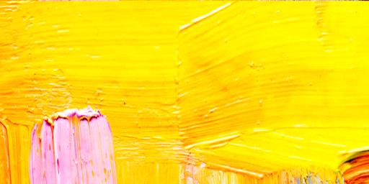
PART.3
70%
5%
5%
10%
单击此处
添加名称

Slide 21

PART.4
This template is the spring and autumn advertising original, here you can directly modify the content. This template is the spring and autumn advertising original, here you can directly modify the content.

Slide 22

PART.4
添加标题
This template is the spring and autumn advertising original, here you can directly modify the content. This template is the spring and autumn advertising original, here you can directly modify the content.

Slide 23
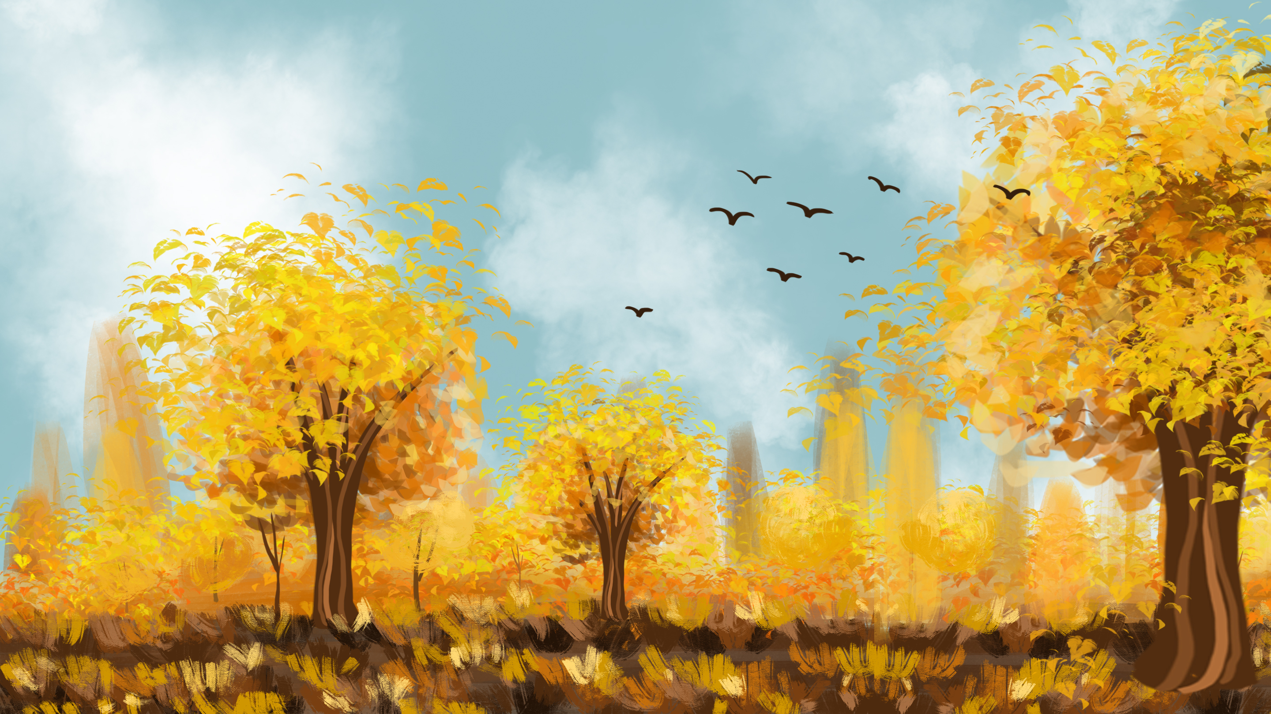
PART.4
添加标题
添加标题
This template is the spring and autumn advertising original, here you can directly modify the content. This template is the spring and autumn advertising original, here you can directly modify the content.
This template is the spring and autumn advertising original, here you can directly modify the content. This template is the spring and autumn advertising original, here you can directly modify the content.

Slide 24
再也不是 的过客

